Slide 1
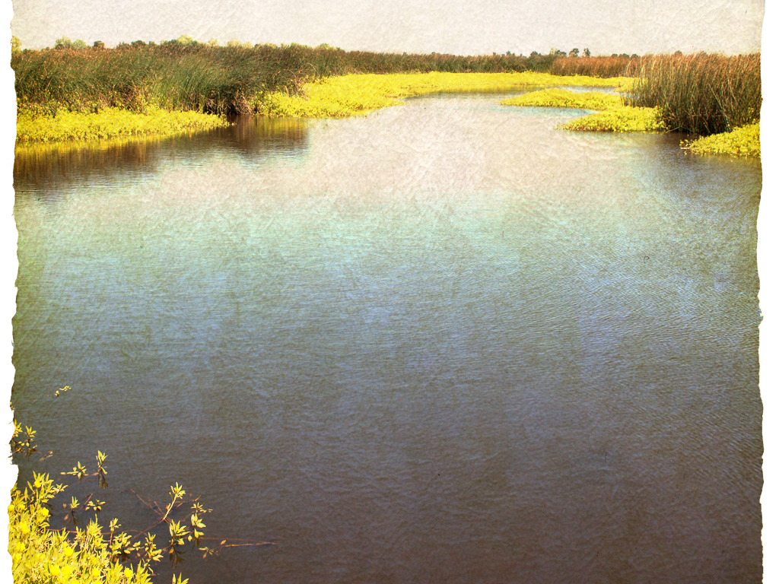
Who We Are
Who We Are
Our mission is to ensure the health of the San Francisco Bay-Delta estuary and Delta communities.
Barbara Barrigan-Parrilla
Executive Director
Barbara@RestoretheDelta.org
(209) 479-2053
Barbara Barrigan-Parrilla
Executive Director
Barbara@RestoretheDelta.org
(209) 479-9550

Slide 2
Today’s Presentation:
Who we are
Voluntary Agreements and Delta Flows
Harmful Algal Blooms as threat to homeless, public health, air quality and data
Local Flood Protection Initiatives/Levee Safety/Climate Change
Delta Tunnel
Cal Enviro Screen
Changing Behavior to protect waterways
Get Involved
Connect With Us
Change The Policy
Notes:
Who we are: state campaigns on Delta and California water management; Stockton EJ invitiative; water, air, environmental justice, policy driven planning
Agenda: Updates on topics

Slide 3
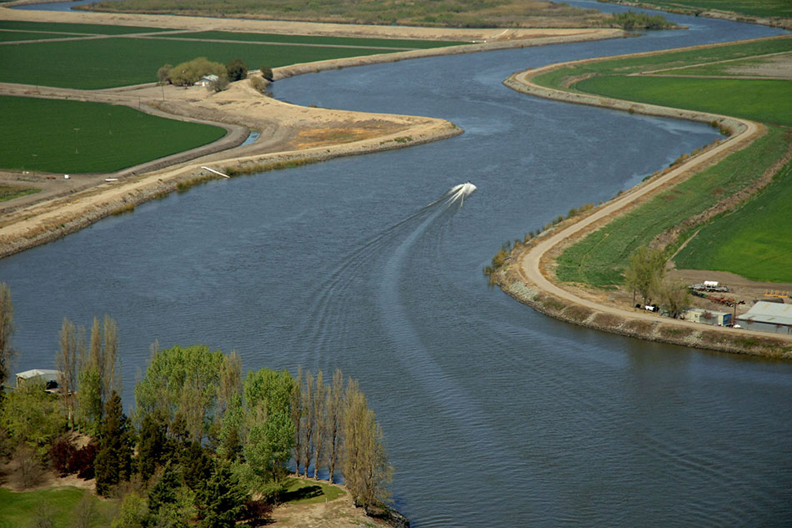
Voluntary Agreements & Flows Have you read the op-ed written by us and the Winnemem Wintu Tribe in the SJ Merc News? Link:
https://www.mercurynews.com/2021/09/18/opinion-governor-must-integrate-justice-into-state-water-policy/

Slide 4
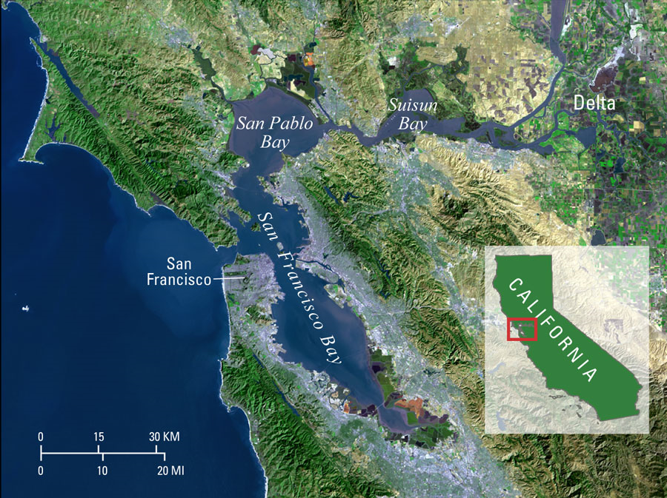
Notes:
Quick reminder – the Delta is the Bay-Delta estuary – largest estuary on the West Coast of the Americas – 60% of the State’s river system drains through the Delta, just west of Stockton confluence of Sac and SJ Rivers. Flows and water quality standards are to be set through triannal reviews under the Clean Water Act. We are about 24 years behind. 2018 – Bay-Delta Plan Phase I completed. Will now be implemented, but VA’s continue on the Sac River side for the tunnel (still a problems because 80% of flow is from Sac River. And then combined flows. DWR botched operations and drought reveal problems with VA/s and need for flows.

Slide 5
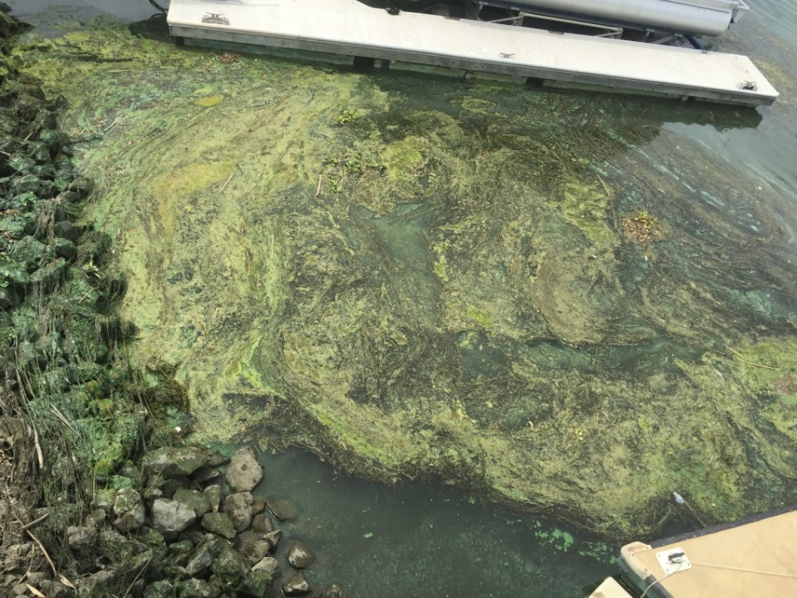
Harmful Algal Blooms (HABs)
Heat, sun, warm water, nitrates, lack of circulation
Cyanobacteria 200 times over the threshold for dangerous levels last year
Accumulating contaminants
Fish contamination
Degraded water quality
Water Quality Impacts
on Bay-Delta Communities
Notes:
25 reported incidents in the Delta this season. We have a tracking program – significant expansion presently. By next year we will have full science-based program up and running.

Slide 6
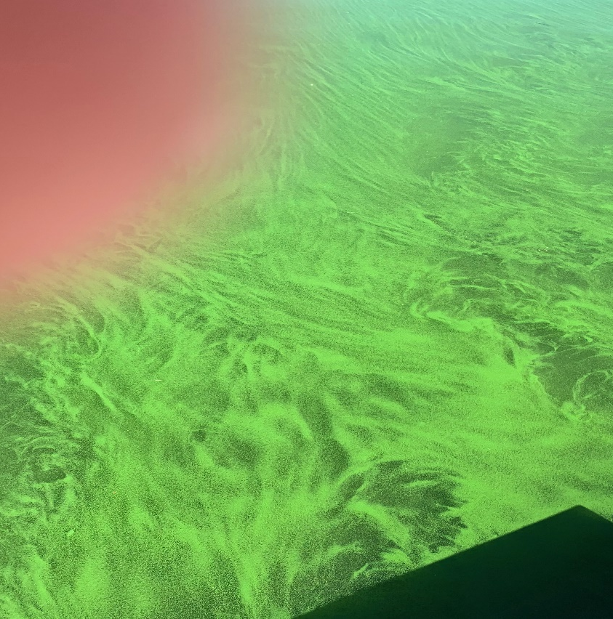
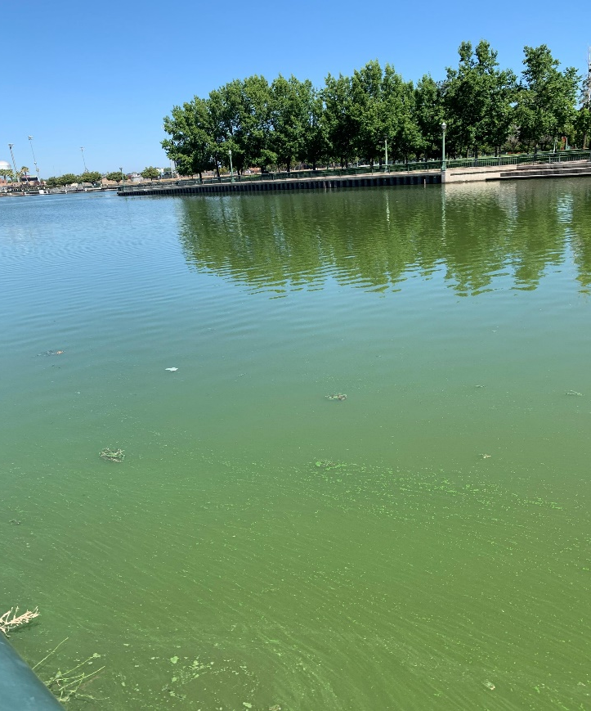
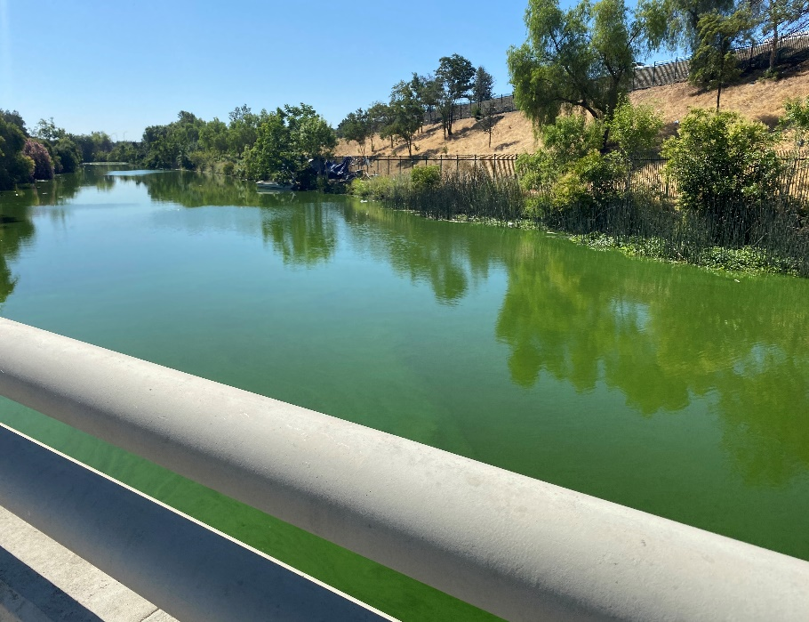
Causes:
Warmer water & air temps
Sunlight
Lack of flow
Discharge, nitrate pollution
Harmful algal blooms (HABs)
Benthic Mats
Spread from SJ River & Port of Stockton
2020 & 2021 Delta Waterways (SJ County) 220 times over danger level for microcystins (Bacteria)
Danger Levels at Big Break, Franks Tract, Stockton
Threat of Spread into the Bay
Notes:
Health impacts from HABs include liver damage in small children – nerve damage damage (if water is ingested); skin conditions; respiratory disease from breathing in water droplets which can travel 7 miles – air pollution (US EPA is studying emissions) – EJ Communities where this is happening and homeless are encamped are at bottom 96 percentile for environmental health, and air pollution –homeless are living with the danger of being next to contraminated waters, using for sanitation; bad air quality – pets are dying from entering waterways (and if they become sick from cyanobacteria – often cannot communicate source of illness. DNA shows discharge other than ecampments is main pollutant

Slide 7
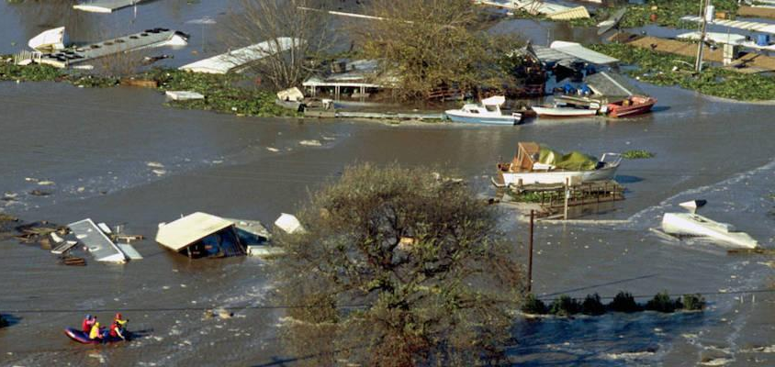
Delta Flood Threat
If you live in the #BayDelta, the odds that you'll witness a flood this year are slim—about 1 in 50.
But by the time today's kindergartners start retiring, over 1 in 5 Delta dwellers will be #flooded in a given year.
#DeltaScience #CAwater #Climate
https://www.sfestuary.org/estuary-news-delta-study-predicts-climate-risk/
Notes:
Levee integrity --- levees are what keep us safe in the present (great engineering) and improvements need to be made in the future to keep us safe. Most vulnerable point
in the system is South Stockton due to a combination of inundation down the SJ, sea level rise and storm surge. Encampments have the potential to erode levees. Homeless need to be made aware of levee protection and safety.

Slide 8
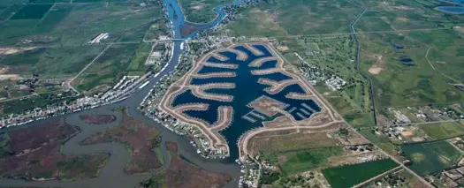
Delta Conveyance Project
From Bad To Worse!
This blog explains it all!
https://www.restorethedelta.org/2021/10/19/delta-flows-the-delta-conveyance-project-from-bad-to-worse/

Slide 9
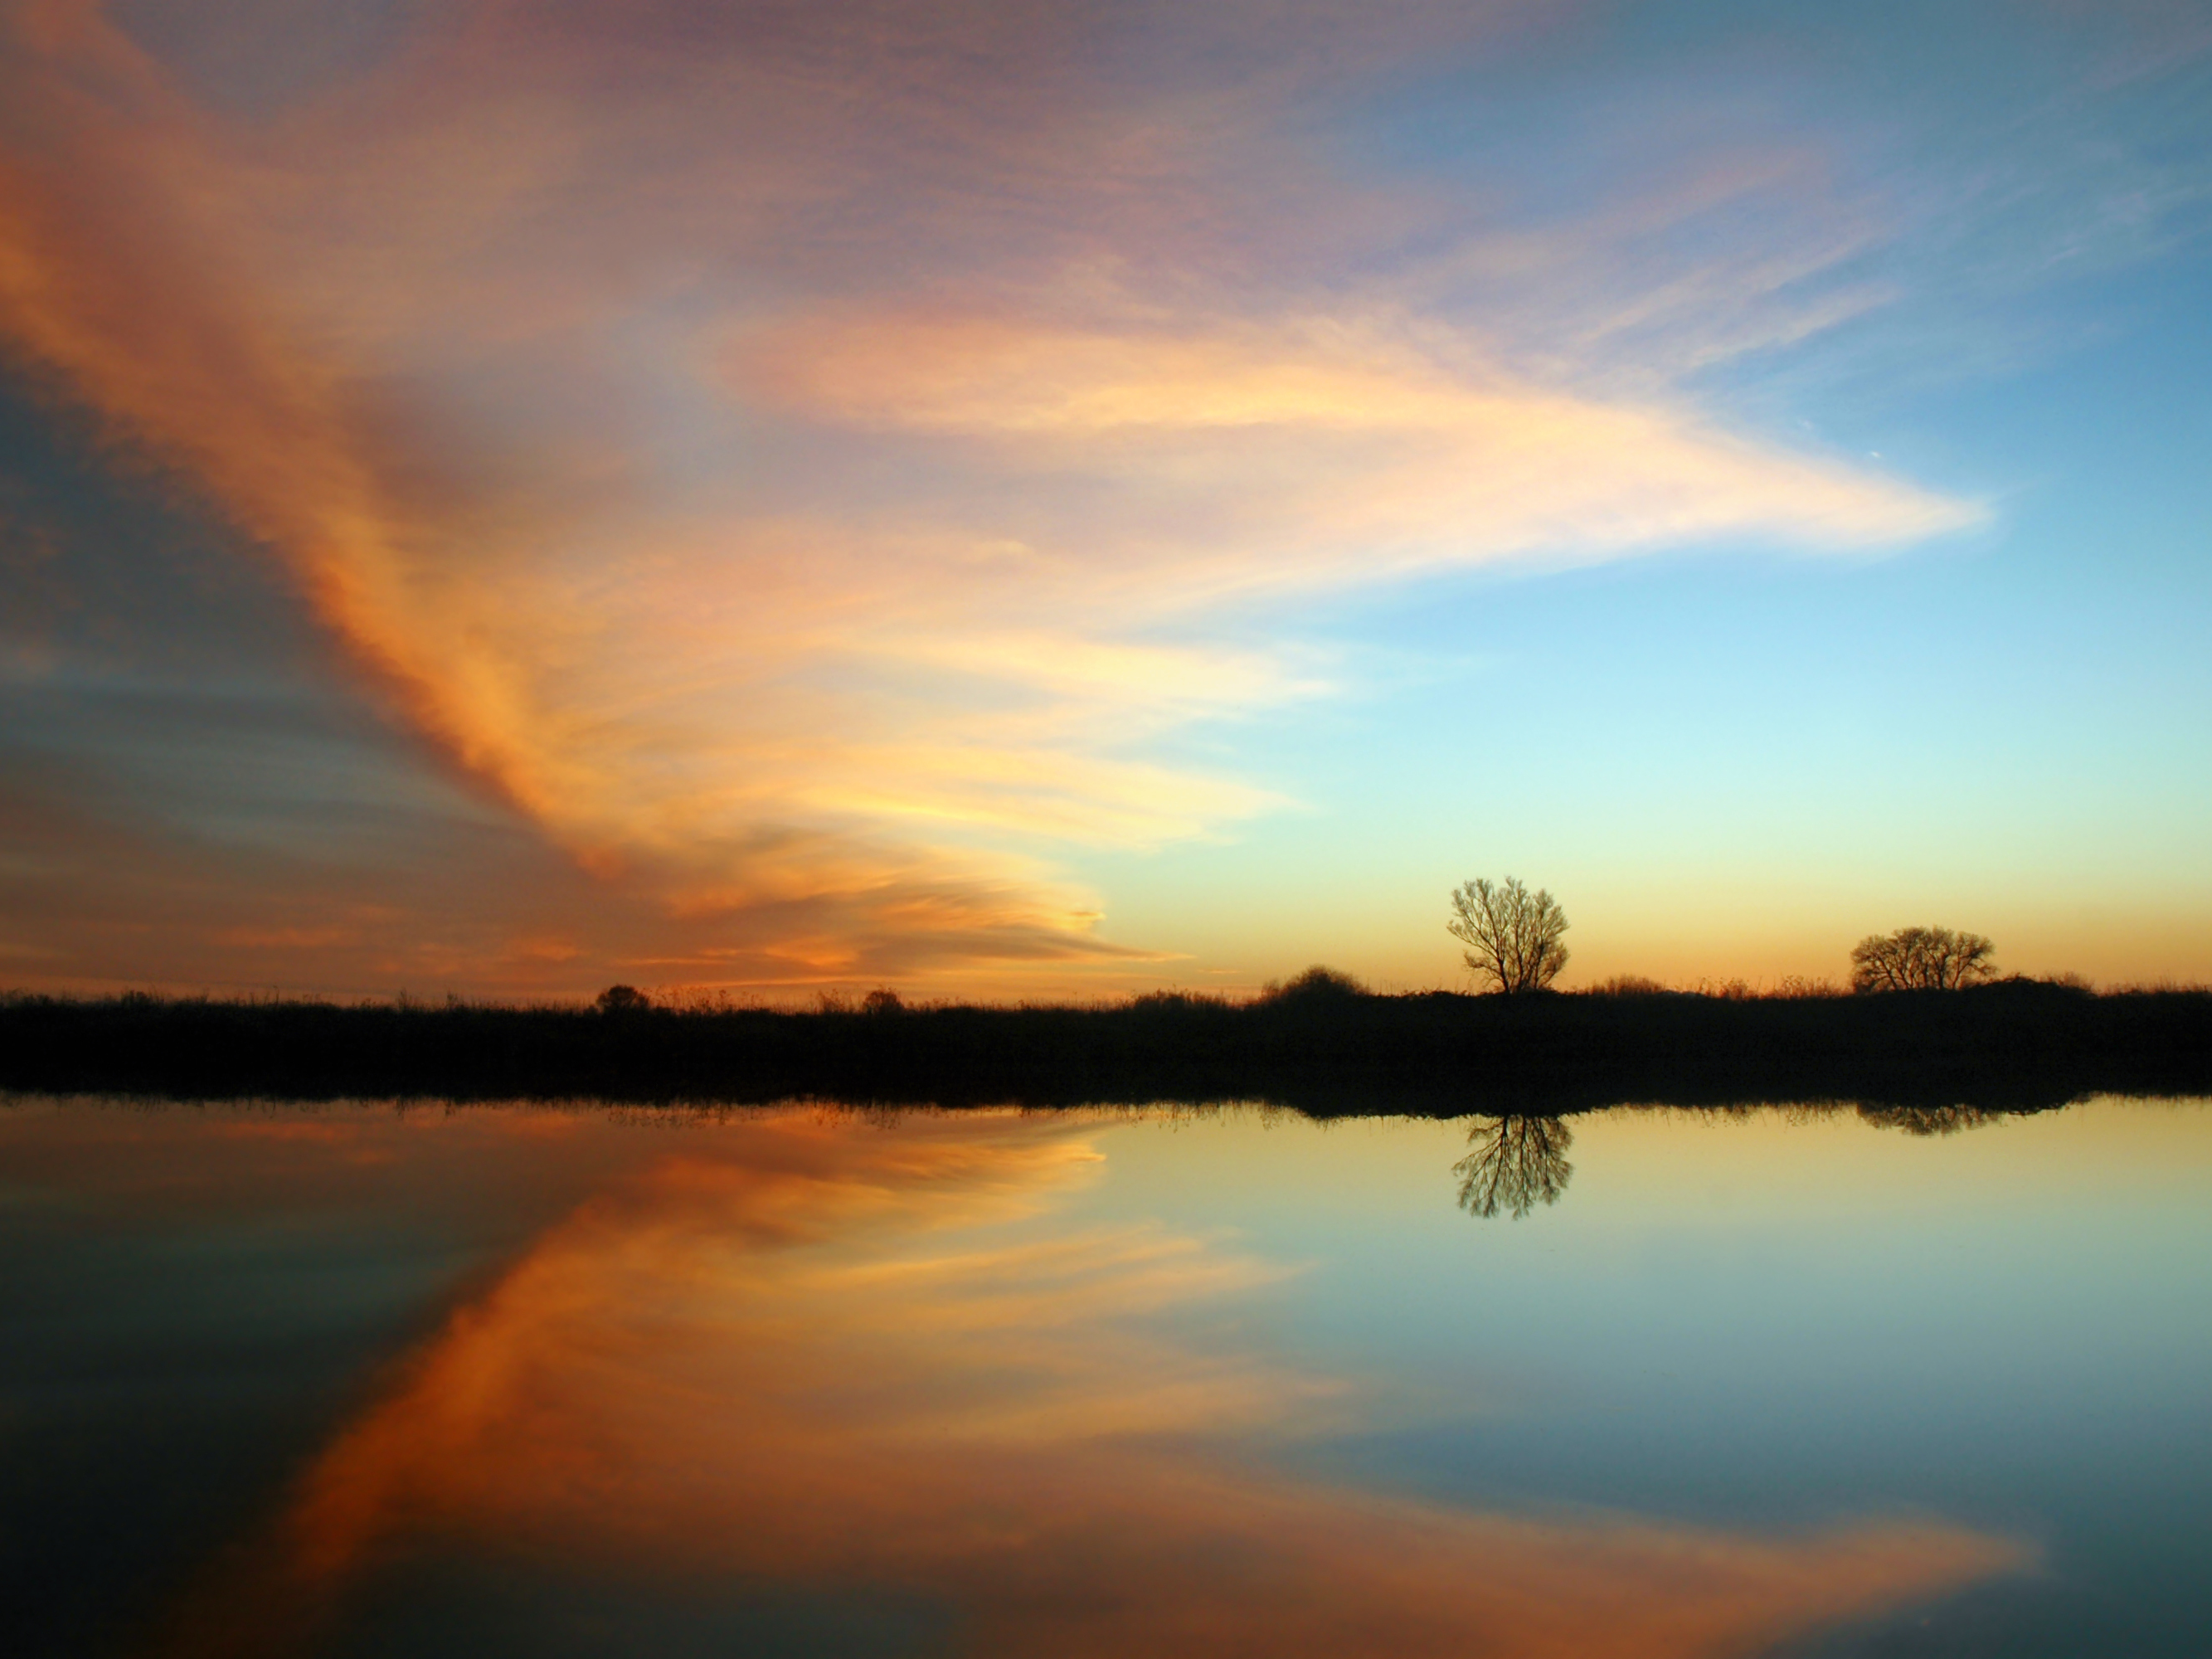
Mechanical Carbon Sequestration
Did you listen to our pro and con event last week?
Watch Restore the Delta's first virtual session in our Dine & Learn series on Carbon Sequestration in the Delta here: https://www.youtube.com/watch?v=eCxsfYJMW3s
Lawrence Livermore National Laboratory scientists, Briana Schmidt and George Peridas have collectively spent decades studying the technologies involved and will be providing an overview of how they work, the science behind them, their risks and benefits, and how Delta residents and communities can evaluate proposed projects.Speakers included Tom Zuckerman (Delta farmer and water expert), Matt Holmes (Environmental Justice Director, Little Manila Rising), Briana Schmidt (Scientist, Lawrence Livermore National Lab), and George Peridas (Scientist, Lawrence Livermore National Lab).
Note from RTD: This webinar was not an endorsement of the project, but an opportunity for our community to hear from those working in this area and learn so that they are able to make educated decisions for themselves. We believe that everyone should have access to the same information, whether you work in the environmental field or not.

Slide 10
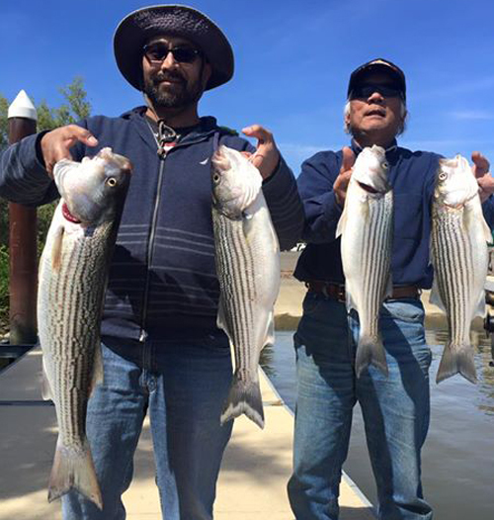
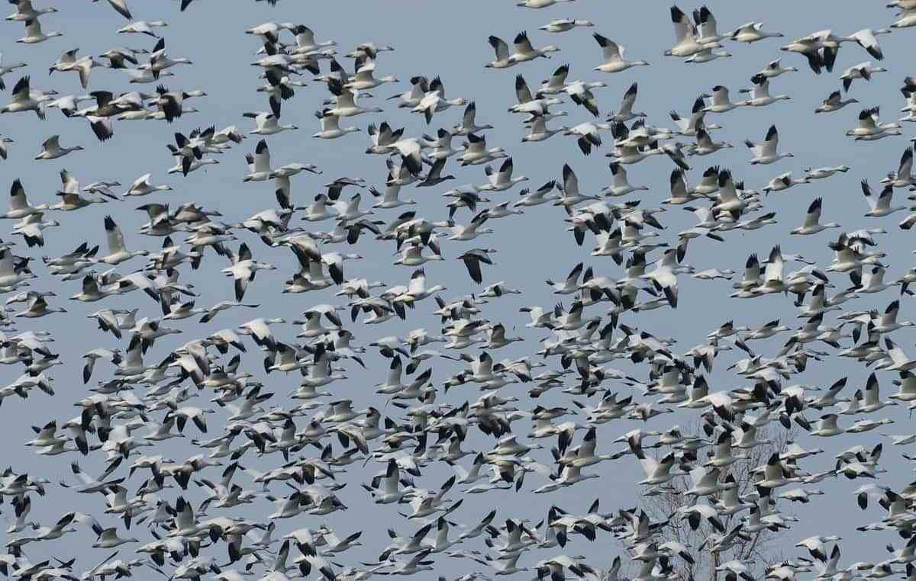
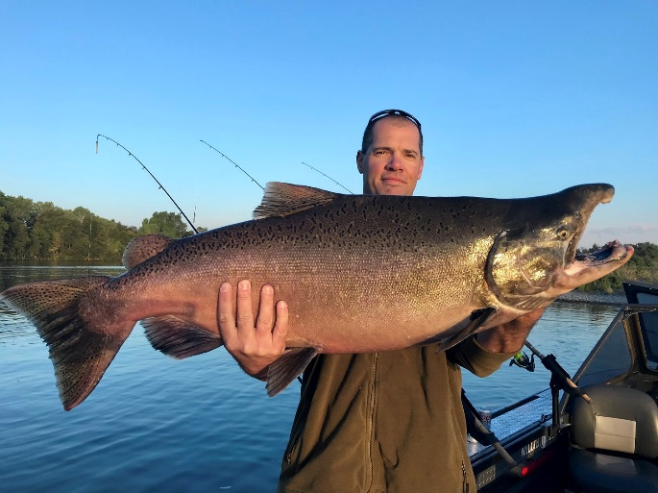
Data on Environmental Health
https://oehha.ca.gov/calenviroscreen/report/calenviroscreen-40
Notes:
Status of our EJ communities.

Slide 11
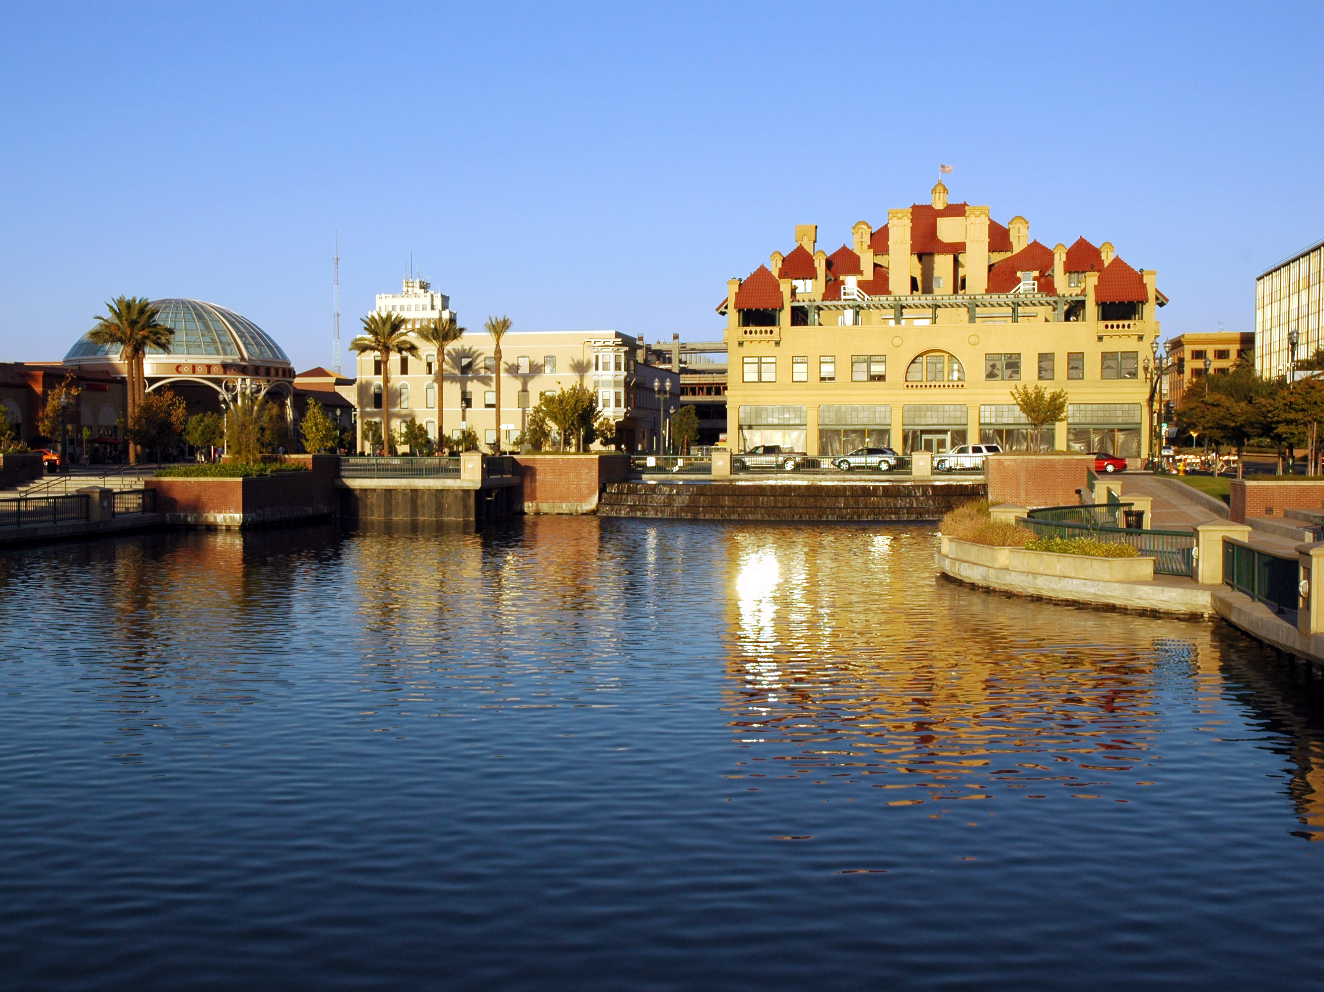
The Delta has 4 million residents. 34% of these residents make up the Environmental Justice Community.
Programs that can make homeless residents stewards of the Delta:
Providing literature and training to groups that provide services to discuss levee safety, pollution, and waterway safety
Incentivize stewardship
HABs Tracking and Reporting to Change Policies: We have additional burden of HABs. We need to work with homeless to keep them safe from this environmental burden. Port Compliance is part of stopping the problem.
Policy work and campaigns at State Water Resources Control Board and Regional Waterways Plan in 2022.
Delta Stewardship Council Social Science Efforts.
EIR Summer 2022 for the Delta Tunnel.
Restore the Delta is here to help.

Slide 12
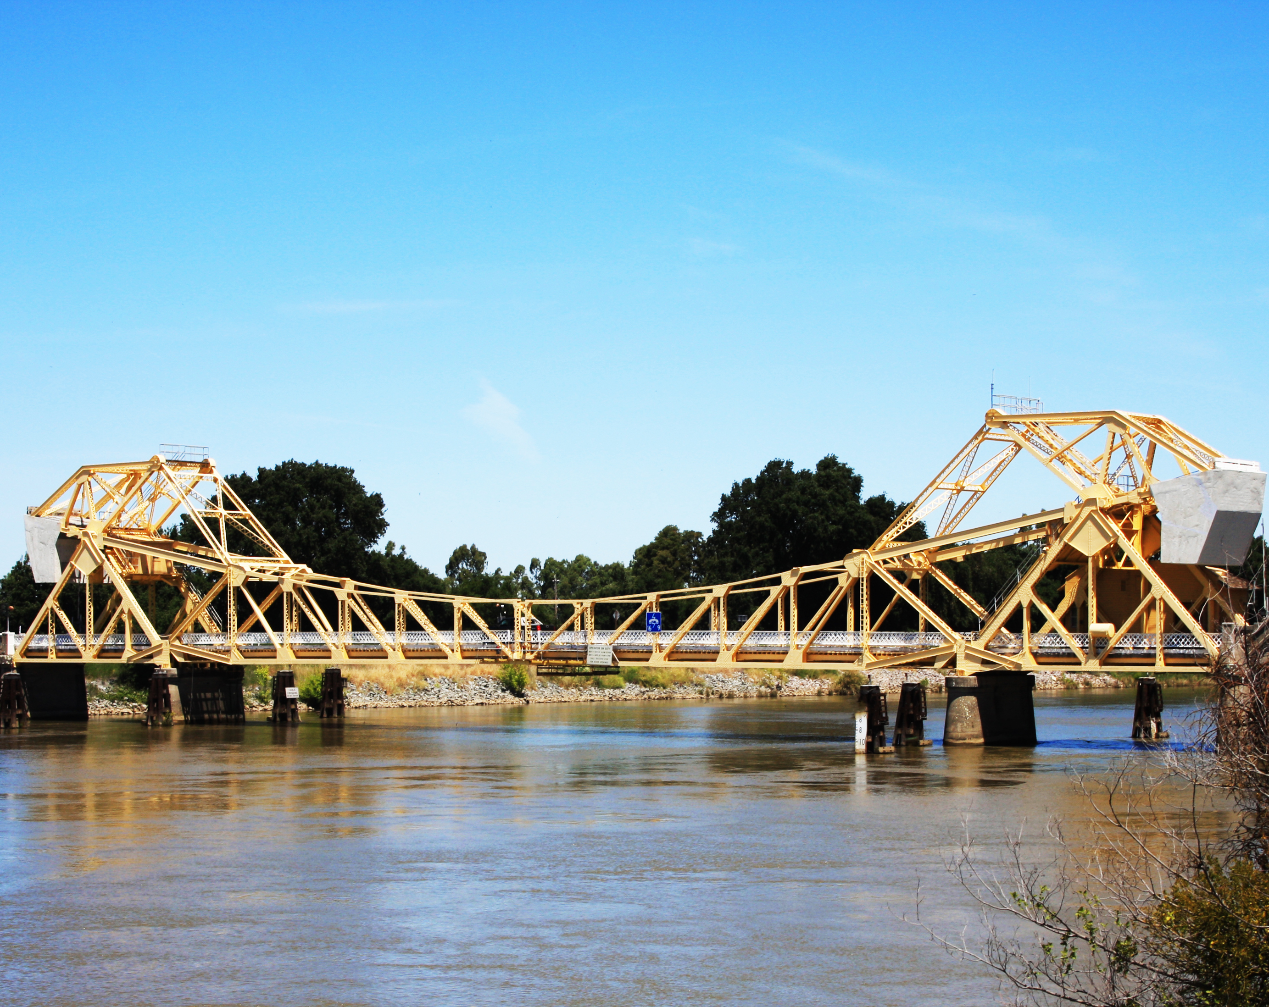
How You Can Support Us
Restore the Delta is a rare combination of good outreach and solid policy work. We are working every day through public education and citizen activism to ensure the restoration and future sustainability of the SF Bay-Delta estuary.
Your tax-deductible contribution will help enable us to educate Californians on what makes the Delta so special, and assist us in building a coalition centered on sustainable water policies for the Delta and California that will be recognized by government officials as they make water management decisions.
www.restorethedelta.org/donate

